Slide 1
Text Mining
ADVANCED SOCIAL,
TEXT AND MEDIA ANALYTICS
DEPARTMENT OF CSBS

Slide 2
UNIT – I
Text Mining: Introduction, Core text mining operations, Preprocessing techniques, Categorization, Clustering, Information extraction, Probabilistic models for information
extraction, Text mining applications, Methods & Approaches: Content Analysis;

Slide 3
What is Text Mining
Text mining, also known as text data mining, is the process of transforming unstructured text into a structured format to identify meaningful patterns and new insights.

Slide 6
Cont ..
By applying advanced analytical techniques, such as Naïve Bayes, Support Vector Machines (SVM), and other deep learning algorithms, companies are able to explore and discover hidden relationships within their unstructured data.

Slide 7
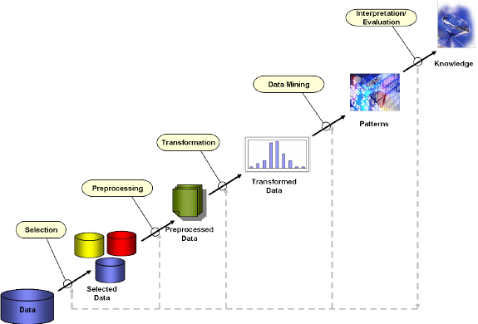
KDD Steps

Slide 8
Types of Data
Text is a one of the most common data types within databases. Depending on the database, this data can be organized as:
Structured data
Semi structured data
Un structured data

Slide 9
Example
Structured data: This data is standardized into a tabular format with numerous rows and columns, making it easier to store and process for analysis and machine learning algorithms. Structured data can include inputs such as names, addresses, and phone numbers.
Unstructured data: This data does not have a predefined data format. It can include text from sources, like social media or product reviews, or rich media formats like, video and audio files.
Semi-structured data: As the name suggests, this data is a blend between structured and unstructured data formats. While it has some organization, it doesn’t have enough structure to meet the requirements of a relational database. Examples of semi-structured data include XML, JSON and HTML files.

Slide 10
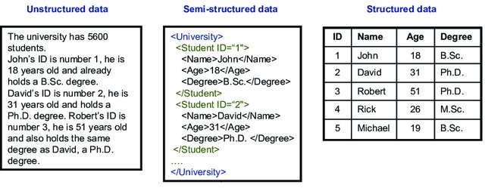
Example

Slide 12
Text Mining Process

Slide 13
High-level text mining functional architecture

Slide 14
Core text mining operations
Core text mining operations consist of various mechanisms for discovering patterns of concept occurrence within a given document collection or subset of a document collection.
The three most common types of patterns encountered in text mining are:
Frequent sets
Associations
Distributions

Slide 15
Frequent and Near Frequent Sets
A set of concepts represented in the document collection with co-occurrences at or above a minimal support level (given as a threshold parameter s; i.e., all the concepts of the frequent concept set appear together in at least s documents).
Although originally defined as an intermediate step in finding association rules, frequent concept sets contain a great deal of information of use in text mining.

Slide 16
Cont ..
Discovery methods for frequent concept sets in text mining build on the Apriori algorithm of Agrawal et al. (1993) used in data mining for market basket association problems.
With respect to frequent sets in natural language application, support is the number (or percent) of documents containing the given rule that is, the co-occurrence frequency.
Confidence is the percentage of the time that the rule is true.

Slide 17
Associations
A formal description of association rules was first presented in the same research on “market basket” problems that led to the identification of frequent sets in data mining.
Subsequently, associations have been widely discussed in literature on knowledge discovery targeted at both structured and unstructured data.

Slide 18
Cont ..
In text mining, associations specifically refer to the directed relations between concepts or sets of concepts.
An association rule is generally an expression of the form A⇒B, where A and B are sets of features.
An association rule A⇒B indicates that transactions that involve A tend also to involve B.

Slide 19
Example
From the original market-basket problem, an association rule might be 25 percent of the transactions that contain milk also contain bread; 8 percent of all transactions contain both items.
In this example, 25 percent refers to the confidence level of the association rule, and 8 percent refers to the rule’s level of support.

Slide 20
Distributions
Concept Selection
Concept Proportion
Conditional Concept Proportion
Concept Proportion Distribution
Conditional Concept Proportion Distribution
Average Concept Proportion
Average Concept Distribution

Slide 21
Pre-processing techniques
A few of the most common preprocessing techniques used in text mining are tokenization, term frequency, stemming and lemmatization.
Tokenization
Term frequency
Stemming
Lemmatization

Slide 22
Stop word removal
Original text
Information systems Asia web provides research, is related commercial materials, interaction, and even research sponsorship by interested corporations with a focus on Asia pacific region.
Survey of information retrieval guide to ir, with an emphasis on web-based projects. Includes a glossary, and pointers to interesting papers.
After the stop-words removal
Information systems Asia web provides research related commercial materials interaction research sponsorship interested corporations focus Asia pacific region
Survey information retrieval guide ir emphasis web based projects includes glossary pointers interesting papers

Slide 23
Tokenization
Tokenization is the process of breaking text up into separate tokens, which can be individual words, phrases, or whole sentences.
In some cases, punctuation and special characters (symbols like %, &, $) are discarded in the process.

Slide 24
Python Implementation

Slide 25
Term Frequency
Term frequency tells you how much a term occurs in a document. Terms can be either individual words or phrases containing multiple words. Since documents differ in length, it’s possible that a term would appear more times in longer documents than shorter ones. Thus, you can calculate term frequency by dividing the number of times the term appears, by the total number of terms in the document, as a way of normalization.
Term Frequency = [Number of times the term appears in the document] / [Total number of terms in the document]

Slide 26
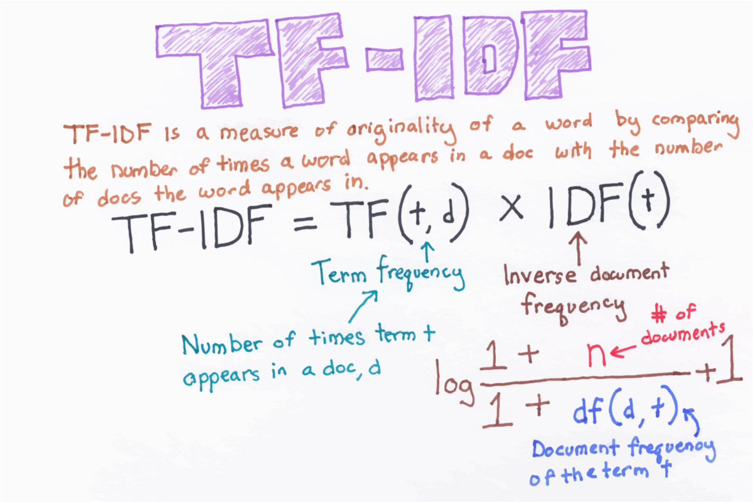
TF-IDF

Slide 27
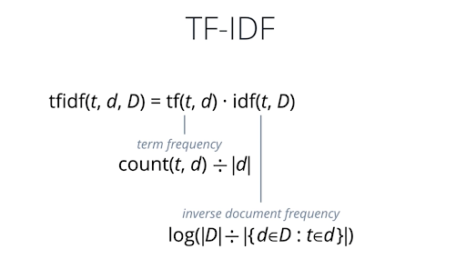
Cont ..

Slide 28
Python implementation for TF

Slide 29
Stemming
Stemming is the process of reducing words to their root form.
For example, we would reduce the word robotics to the stem robot.
For example, the Porter stemmer, a widely used algorithm for removing common suffixes from English words, reduces the words universal, university, and universe to the stem univers.

Slide 30
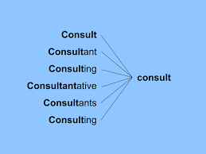
Example

Slide 31
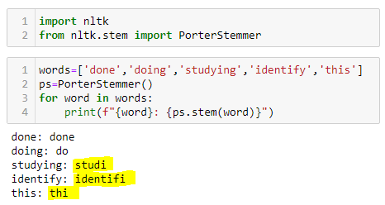
Python Implementation -1

Slide 32
Python Implementation -2

Slide 33
Types of Stemming Algorithms

Slide 34
Lemmatization
As we saw with the Porter stemmer example, the simple suffix rules that are commonly used for stemming could modify the stem.
Lemmatization is a more complex approach to determining word stems, which addresses this potential problem. In lemmatization, we use different normalization rules depending on a word’s lexical category (part of speech).
The stemmer can grasp more information about the word being stemmed, and use that to group similar words more accurately.

Slide 35
Example

Slide 36
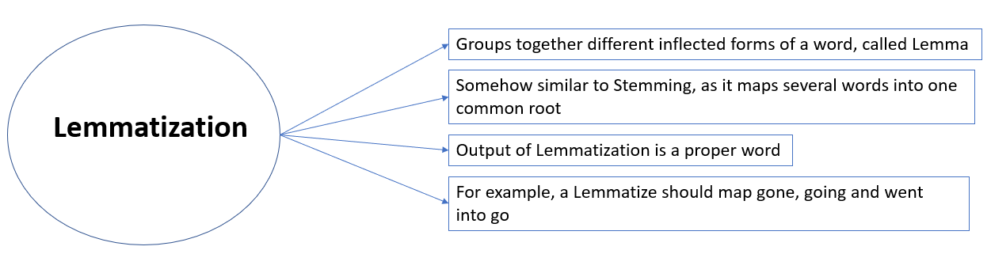
Cont ..

Slide 37
Stemming Vs Lemmatization

Slide 38
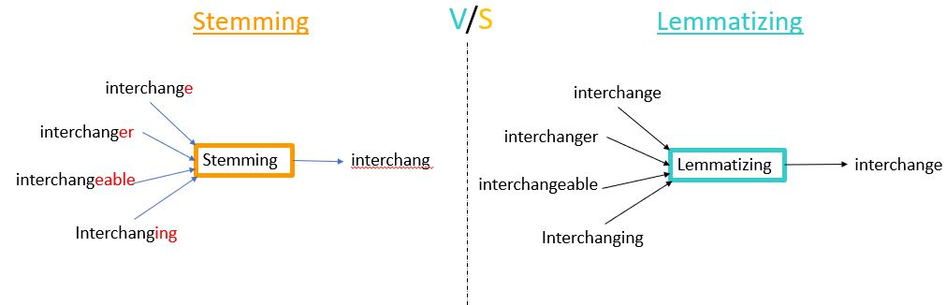
Cont ..

Slide 39
Approaches to Lemmatization
We will be going over 9 different approaches to perform Lemmatization along with multiple examples and code implementations.
WordNet
WordNet (with POS tag)
TextBlob
TextBlob (with POS tag)
spaCy
TreeTagger
Pattern
Gensim
Stanford CoreNLP

Slide 40
Categorization

Slide 41
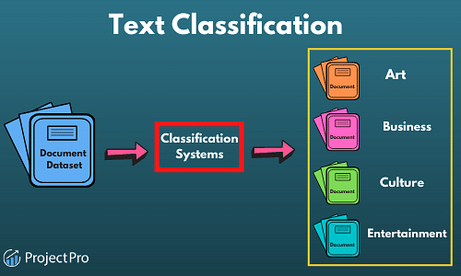

Slide 42
Classification Process (1): Model Construction
Classification
Algorithms
Training
Data
Classifier
(Model)
IF rank = ‘professor’
OR years > 6
THEN tenured = ‘yes’

Slide 43
Classification Process (2): Use the Model in Prediction
Classifier
Testing
Data
Unseen Data
(Jeff, Professor, 4)
Tenured?

Slide 48
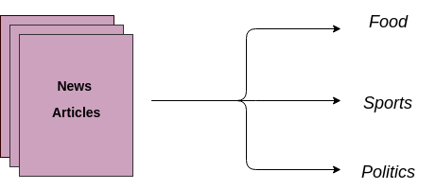
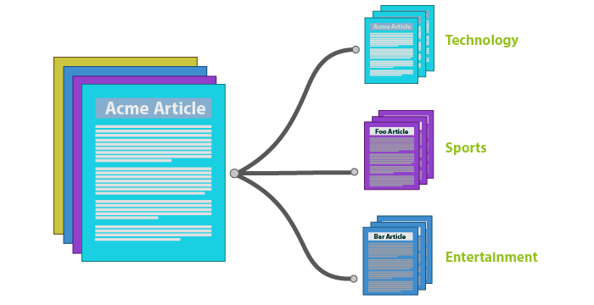

Slide 52
Vectorization
A way to extract information from text in the form of word sequences, we need a way to transform these word sequences into numerical features: this is vectorization.
The simplest text vectorization technique is Bag Of Words (BOW). It starts with a list of words called the vocabulary (this is often all the words that occur in the training data). Then, given an input text, it outputs a numerical vector which is simply the vector of word counts for each word of the vocabulary.

Slide 55
Example
Training texts: ["This is a good cat", "This is a bad day"] => vocabulary: [this, cat, day, is, good, a, bad]
New text: "This day is a good day" -->
[1, 0, 2, 1, 1, 1, 0]
Example-2, if we have defined our dictionary to have the following words {This, is, the, not, awesome, bad, basketball}, and we wanted to vectorize the text “This is awesome,” we would have the following vector representation of that text: (1, 1, 0, 0, 1, 0, 0).

Slide 57
Term Frequency
We can use Term Frequency (TF) instead of word counts and divide the number of occurrences by the sequence length.
We can also downscale these frequencies so that words that occur all the time (e.g., topic-related or stop words) have lower values. This downscaling factor is called Inverse Document Frequency (IDF) and is equal to the logarithm of the inverse word document frequency.
Put together, these new features are are called TF-IDF features. So in summary:

Slide 64
Clustering
Clustering: the process of grouping a set of objects into classes of similar objects
Documents within a cluster should be similar.
Documents from different clusters should be dissimilar.
The commonest form of unsupervised learning
Unsupervised learning = learning from raw data, as opposed to supervised data where a classification of examples is given
A common and important task that finds many applications in IR and other places

Slide 65
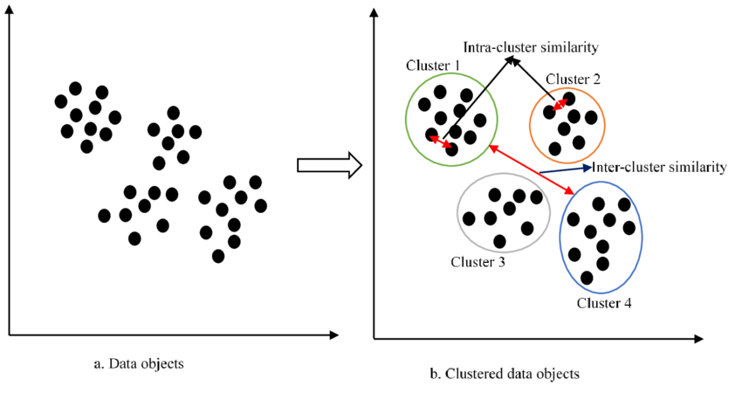

Slide 66
Good Cluster
Internal criterion: A good clustering will produce high quality clusters in which:
The intra-class (that is, intra-cluster) similarity is high.
The inter-class similarity is low.
The measured quality of a clustering depends on both the document representation and the similarity measure used

Slide 67
https://devopedia.org/text-clustering#qst-ans-1
https://www.kaggle.com/code/karthik3890/text-clustering#Introduction

Slide 68
Similarity Measures

Slide 69
Use cases of clustering algorithms
Document Clustering
Recommendation Engine
Image Segmentation
Market Segmentation
Search Result Grouping

Slide 70
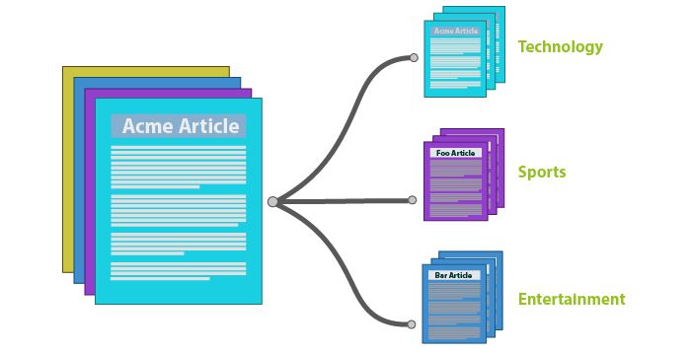
Document Clustering

Slide 71
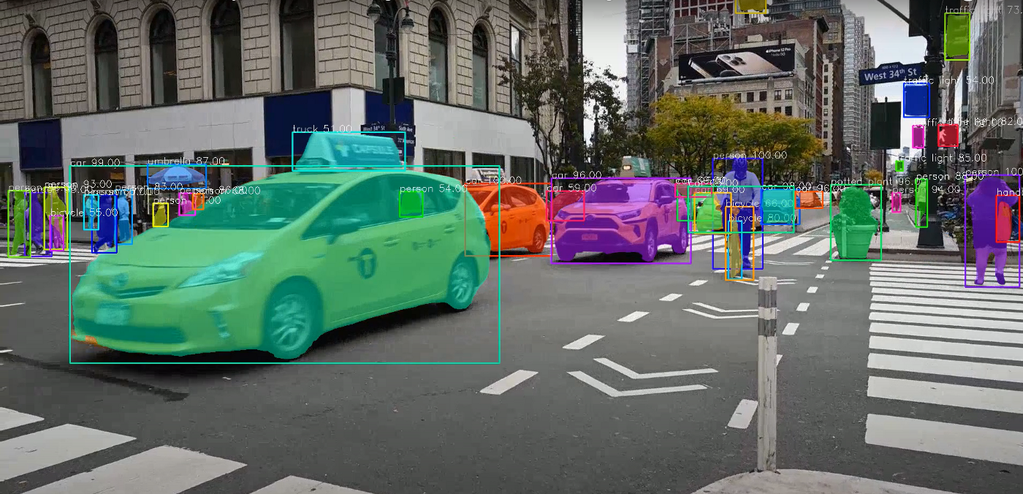
Image Segmentation

Slide 72
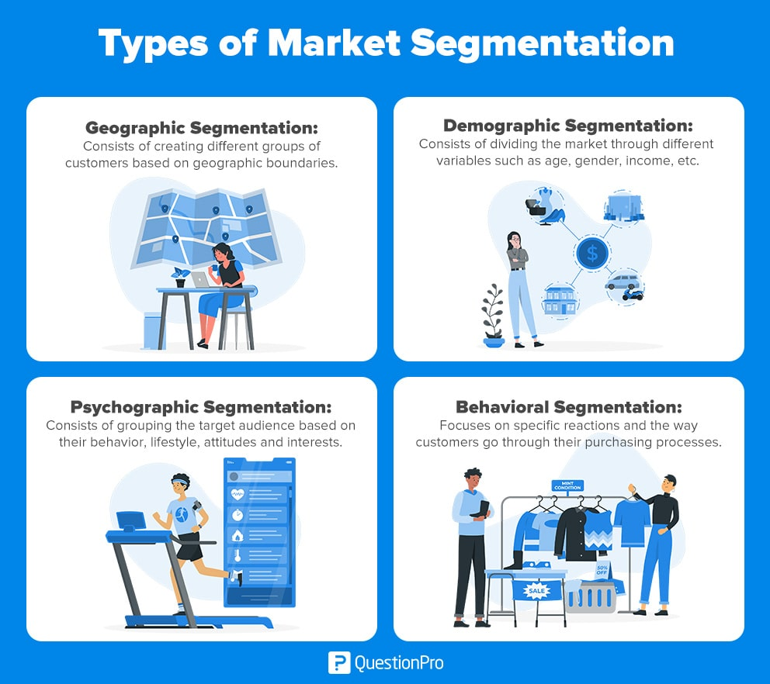

Slide 73
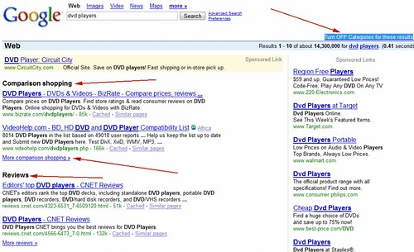
Search Result Grouping

Slide 74
Types of Clustering Techniques
Partitioning Methods
Hierarchical Methods
Density-Based Methods
Grid-Based Methods
Model-Based Clustering Methods

Slide 75
Major Clustering Approaches
Partitioning algorithms: Construct various partitions and then evaluate them by some criterion
Hierarchy algorithms: Create a hierarchical decomposition of the set of data (or objects) using some criterion
Density-based: based on connectivity and density functions
Grid-based: based on a multiple-level granularity structure
Model-based: A model is hypothesized for each of the clusters and the idea is to find the best fit of that model to each other

Slide 76
Partitioning Algorithms: Basic Concept
Partitioning method: Construct a partition of a database D of n objects into a set of k clusters
Given a k, find a partition of k clusters that optimizes the chosen partitioning criterion
Global optimal: exhaustively enumerate all partitions
Heuristic methods: k-means and k-medoids algorithms
k-means (MacQueen’67): Each cluster is represented by the center of the cluster
k-medoids or PAM (Partition around medoids) (Kaufman & Rousseeuw’87): Each cluster is represented by one of the objects in the cluster

Slide 77
The K-Means Clustering Method
Given k, the k-means algorithm is implemented in 4 steps:
1. Partition objects into k nonempty subsets
2. Compute seed points as the centroids of the clusters of the current partition. The centroid is the center (mean point) of the cluster.
3. Assign each object to the cluster with the nearest seed point.
4. Go back to Step 2, stop when no more new assignment.

Slide 78
The K-Means Clustering Method

Slide 79
Hierarchical Clustering
Use distance matrix as clustering criteria. This method does not require the number of clusters k as an input, but needs a termination condition
Step 0
Step 1
Step 2
Step 3
Step 4
agglomerative
(AGNES)
a
a b
b
a b c d e
c
c d e
d
d e
e
divisive
(DIANA)
Step 4
Step 3
Step 2
Step 1
Step 0

Slide 80
AGNES (Agglomerative Nesting)
Introduced in Kaufmann and Rousseeuw (1990)
Implemented in statistical analysis packages, e.g., Splus
Use the Single-Link method and the dissimilarity matrix.
Merge nodes that have the least dissimilarity
Go on in a non-descending fashion
Eventually all nodes belong to the same cluster

Slide 81
DIANA (Divisive Analysis)
Introduced in Kaufmann and Rousseeuw (1990)
Implemented in statistical analysis packages, e.g., Splus
Inverse order of AGNES
Eventually each node forms a cluster on its own

Slide 82
CHAMELEON
CHAMELEON: hierarchical clustering using dynamic modeling, by G. Karypis, E.H. Han and V. Kumar’99
Measures the similarity based on a dynamic model
Two clusters are merged only if the interconnectivity and closeness (proximity) between two clusters are high relative to the internal interconnectivity of the clusters and closeness of items within the clusters
A two phase algorithm
Use a graph partitioning algorithm: cluster objects into a large number of relatively small sub-clusters
2. Use an agglomerative hierarchical clustering algorithm: find the genuine clusters by repeatedly combining these sub-clusters

Slide 83
Overall Framework of CHAMELEON
Construct
Sparse Graph
Partition the Graph
Data Set
Merge Partition
Final Clusters

Slide 84
Density-Based Clustering Methods
Clustering based on density (local cluster criterion), such as density-connected points
Major features:
Discover clusters of arbitrary shape
Handle noise
One scan
Need density parameters as termination condition
Several interesting studies:
DBSCAN: Ester, et al. (KDD’96)
OPTICS: Ankerst, et al (SIGMOD’99).
DENCLUE: Hinneburg & D. Keim (KDD’98)
CLIQUE: Agrawal, et al. (SIGMOD’98)

Slide 85
DBSCAN: Density Based Spatial Clustering of Applications with Noise
Relies on a density-based notion of cluster: A cluster is defined as a maximal set of density-connected points.
Discovers clusters of arbitrary shape in spatial databases with noise
Outlier
Border
Eps = 1cm
MinPts = 5
Core

Slide 86
Cont ..
Core Point: A data point is considered a core point if there are at least "minPts" data points, including itself, within an epsilon (EPS) distance of it.
Border Point: A data point is considered a border point if it is within the epsilon neighborhood of a core point but does not have enough neighboring data points to be classified as a core point itself.
Noise Point (Outlier): A data point is considered a noise point or an outlier if it is neither a core point nor a border point.

Slide 87
Cont ..
"EPS" stands for "Epsilon," and it is a critical parameter that controls the maximum distance between two data points for one to be considered as in the neighborhood of the other. EPS is one of the two primary parameters used in DBSCAN, with the other being "minPts" (minimum number of data points in the epsilon neighborhood required to form a core point).
How EPS works in the context of DBSCAN:
The value of EPS determines the scale or radius of the neighborhood around each data point. It influences how the algorithm groups data points together:
A smaller EPS value will result in tighter and smaller clusters. A larger EPS value will result in larger clusters and may even merge clusters that are close to each other. Choosing an appropriate EPS value is essential to the success of DBSCAN. If the EPS value is too small, you might end up with many noise points and very few clusters. If it's too large, you might merge distinct clusters into one.
Selecting the right EPS value often involves domain knowledge or experimentation. Techniques like the elbow method or visual inspection of the data distribution can help you determine a suitable EPS value for your specific dataset.

Slide 88
DBSCAN: The Algorithm
Arbitrary select a point p
Retrieve all points density-reachable from p wrt Eps and MinPts.
If p is a core point, a cluster is formed.
If p is a border point, no points are density-reachable from p and DBSCAN visits the next point of the database.
Continue the process until all of the points have been processed.

Slide 89
Grid-Based Clustering Method
Using multi-resolution grid data structure
Several interesting methods
STING (a STatistical INformation Grid approach) by Wang, Yang and Muntz (1997)
WaveCluster by Sheikholeslami, Chatterjee, and Zhang (VLDB’98)
A multi-resolution clustering approach using wavelet method
CLIQUE: Agrawal, et al. (SIGMOD’98)

Slide 90
Model-Based Clustering Methods
Attempt to optimize the fit between the data and some mathematical model
Statistical and AI approach
Conceptual clustering
A form of clustering in machine learning
Produces a classification scheme for a set of unlabeled objects
Finds characteristic description for each concept (class)
COBWEB (Fisher’87)
A popular a simple method of incremental conceptual learning
Creates a hierarchical clustering in the form of a classification tree
Each node refers to a concept and contains a probabilistic description of that concept

Slide 91
Information extraction (IE)
The task of Information Extraction (IE) involves extracting meaningful information from unstructured text data and presenting it in a structured format.
Using information extraction, we can retrieve pre-defined information such as the name of a person, location of an organization, or identify a relation between entities, and save this information in a structured format such as a database.

Slide 92
Example

Slide 93
Cont ..

Slide 94
How does Information Extraction work?
We all know that sentences are made up of words belonging to different Parts of Speech (POS). There are eight different POS in the English language: noun, pronoun, verb, adjective, adverb, preposition, conjunction, and intersection.
The POS determines how a specific word functions in meaning in a given sentence. For example, take the word “right”. In the sentence, “The boy was awarded chocolate for giving the right answer”, “right” is used as an adjective. Whereas, in the sentence, “You have the right to say whatever you want”, “right” is treated as a noun.

Slide 95
Information Extraction Architecture
Shows the architecture for a simple information extraction system. first, the raw text of the document is split into sentences using a sentence segmenter, and each sentence is further subdivided into words using a tokenizer.
Next, each sentence is tagged with part-of-speech tags, which will prove very helpful in the next step, named entity detection. In this step, we search for mentions of potentially interesting entities in each sentence. Finally, we use relation detection to search for likely relations between different entities in the text.

Slide 96
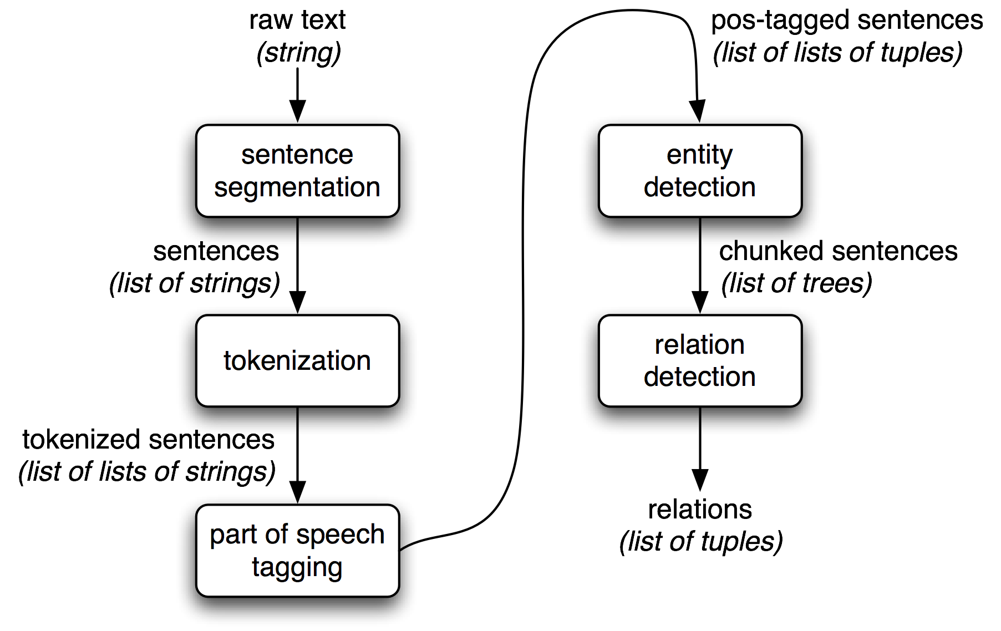
Cont ..
Segmentor
Tokenizer

Slide 97
https://www.nltk.org/book/ch07.html

Slide 98
Probabilistic models for information extraction
http://hanj.cs.illinois.edu/pdf/bkchap12_ysun.pdf
https://link.springer.com/chapter/10.1007/978-1-4614-3223-4_8
https://www.researchgate.net/publication/287910198_Probabilistic_Models_for_Text_Mining

Slide 99
Text Mining Applications
https://www.upgrad.com/blog/what-is-text-mining-techniques-and-applications/
https://www.expert.ai/blog/10-text-mining-examples/
https://www.analyticssteps.com/blogs/what-text-mining-process-methods-and-applications
https://www.repustate.com/blog/text-mining-applications/
https://www.promptcloud.com/blog/best-applications-of-text-mining-analysis/

Slide 100
Text Mining Applications
Spam Filtering
Customer Care Services
Prediction and Prevention of Crime
Risk Management
Knowledge Management
Fraud Detection by Insurance Companies
Personalized Advertising
Business Intelligence
Content Enrichment

Slide 101
Spam Filtering
E-mails are still considered as the most official way of communication in most organizations. But it has a dark side that has only increased in the twenty-first century – spam.
Out of every ten emails in my mailbox, at least nine are spam. Spams not only fill up space but also serve as an entry point for viruses, scams, and more.
Companies are pushing hard to filter more and more spam by using intelligent text analytics as compared to the keyword matching used earlier, to filter out more spam emails and give the user a healthier experience.
In case you run a business that can grow on text scraping and text analytics, remember that data is power, and before you decide how to harness data, make sure you consult someone who has already used data to their benefit or helped others do so.

Slide 102
Customer Care Services
Text mining and natural language processing are frequently being used in customer care services, be it over chat or voice call.
The “ press one for recharge, press two for …..” format has been changed to the “ say yes for account closure or no for cancellation …..” format in many places to make the system appear more humane.
Most banks and e-commerce companies are using natural language processing-based chatbots that try to mimic a human customer care officer when talking to a customer. Improvement in customer care experience is taking place as these bots are using the information on the customer that they are interacting with, to make the experience more customized. By automating customer care services, companies are providing customers a better experience while at the same time, saving money.

Slide 103
Prediction and Prevention of Crime
“Prevention is better than Cure”
So what if you could prevent crimes by knowing beforehand, where and when they might take place. Since the internet is anonymous and so is most of the communication software that operates via it, most criminals plan and communicate using these methods. However, you can understand that millions of normal people use these means of communication as well, and it is a difficult task to pinpoint messages that might be considered a threat.
This is easily done using advanced text analysis software that scans communication sources in real-time and sounds different levels of threat alert on finding different types of text. Law enforcement across the world have been using these technologies to prevent terrorist attacks, catch sleeper cells, and stop people from carrying out other unlawful activities.

Slide 104
Risk Management
Many finance players including banks, microfinance institutions, and others, are now depending on risk management software that can go through documents and profiles to decide on investment risks, credit scores, and more.
The text mining technologies used by such high-end software absorb petabytes of data and present information in a consumable format.
This helps in risk moderation. Such software is helping financial institutions all over the world, to decrease their percentage of non-performing assets.

Slide 105
Knowledge Management
In many industries like the healthcare industry, managing a huge amount of textual information has become a problem. The amount of information gathered every single hour is huge. All this data has to be stored in such a manner that the information can be retrieved as and when required. It may so happen, that there is an epidemic and hospitals need to coordinate to go through all their data to pinpoint the source or the first infected person.
Such a huge exercise would be impossible without the help of proper text analytics systems in place that would manage the data and information and keep them in a structured tree-like format. This would lead to people being able to access the data in any way they need- region-based, gender-based, disease-based, and more. The inability to find important information quickly may cripple such organizations dealing with large volumes of text documents.

Slide 106
Fraud Detection by Insurance Companies
With rising cases of insurance fraud, text analytics has proved effective in going over huge collections of case files to understand the chances of an insurance claim being a fraud. It greatly reduces the workload of the company officials since the fraud recognition software would automatically flag cases where a high probability of fraud is determined.
Insurance companies are tying up with technology giants to take full advantage of the developments in text mining technologies, and combine their results to produce structured data to prevent frauds and swiftly process claims.

Slide 107
Personalized Advertising
Remember how you saw ads of the same mobile phone on Facebook that you were viewing on Amazon? No that is not a coincidence.
Digital advertising has been revolutionized by text and web data mining.
Text data related to all that you type, view, or do online is stored by technology giants, or sold to other companies to show you advertisements that you have a higher probability of clicking on, and which have a higher probability of getting converted into a sale. This is one of the latest and most widely used applications of text analytics and mining.

Slide 108
Business Intelligence
Decision-making is difficult. It is even more difficult when you have to answer to your shareholders as to why you took the decision and how you think that the decision will positively impact the company.
Text mining helps gather evidence and draw up charts and graphs to put the information to back your gut feeling.
Only relevant information and data are extracted so that the people who lead can make the best decisions by going through only a few pages of information.

Slide 109
Content analysis
Content analysis is a research tool used to determine the presence of certain words or concepts within texts or sets of texts.
Researchers quantify and analyze the presence, meanings and relationships of such words and concepts, then make inferences about the messages within the texts, the writer(s), the audience, and even the culture and time of which these are a part.
Texts can be defined broadly as books, book chapters, essays, interviews, discussions, newspaper headlines and articles, historical documents, speeches, conversations, advertising, theater, informal conversation, or really any occurrence of communicative language.

Slide 110
Types of Content Analysis
There are two general types of content analysis:
Conceptual or quantitative analysis
Relational or qualitative analysis.
Conceptual analysis determines the existence and frequency of concepts in a text.
Relational analysis develops the conceptual analysis further by examining the relationships among concepts in a text.
Each type of analysis may lead to different results, conclusions, interpretations and meanings.

Slide 112
Example
https://www.youtube.com/watch?v=dxxES6YYwMs

